Slide 1
bookly
final presentation
Notes:
Alexandra: Vorstellung,Vision

Slide 2

Outline
Use Cases
Demo
Project Management
Architecture
Quality
Notes:
Alexandra
Vision+Agenda (Intro): 2min
Use Cases: 3min
Demo: 3,5min
PM: 3,5-4min
Architecture: 4-4,5min
Quality: 2,5-3min
Further Questions + Documentation: 30s

Slide 3
Use Cases
Notes:
Jeanne

Slide 4
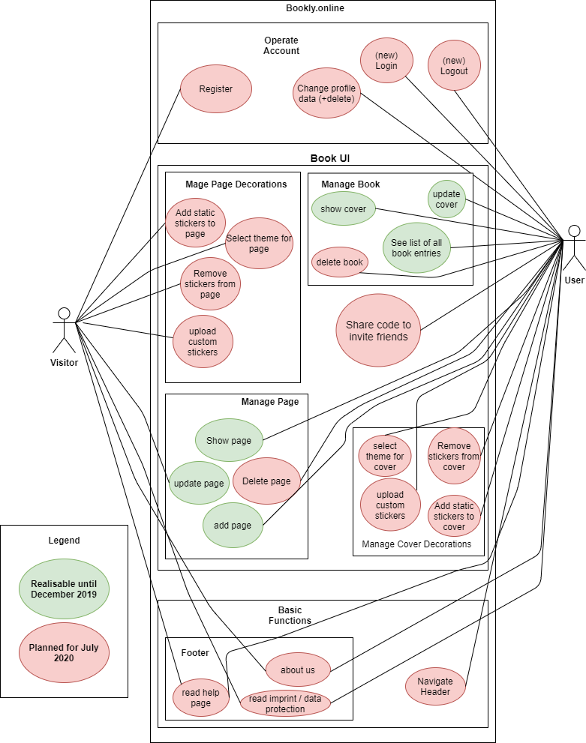
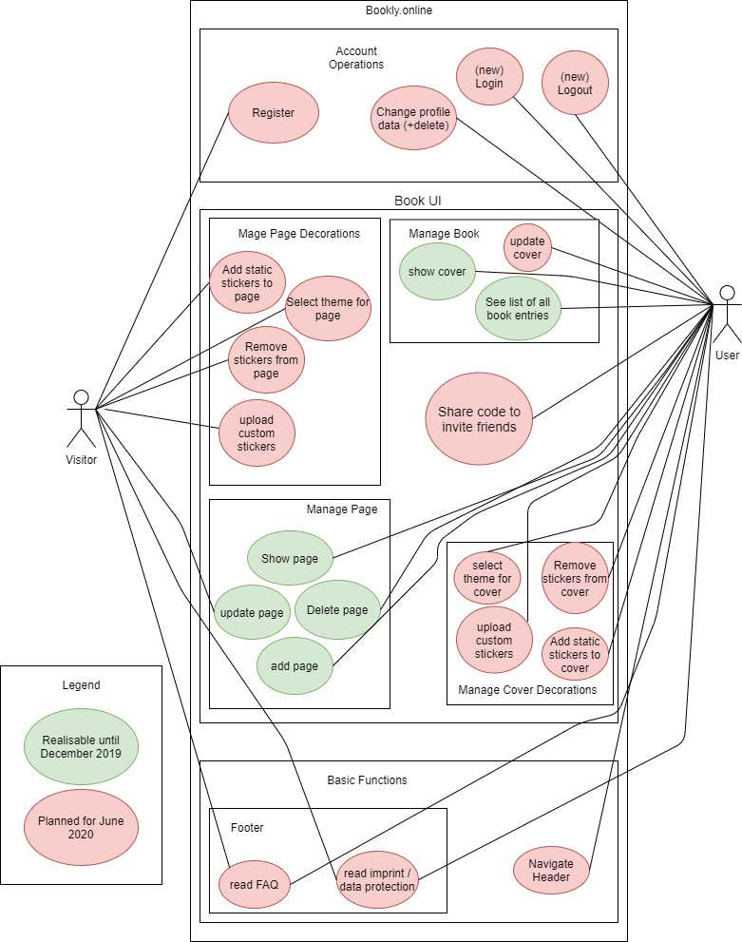
Extend of functionality
Notes:
Jeanne

Slide 5
Extend of functionality
Notes:
Jeanne

Slide 6
Use Cases
Manage page
C: create page entry (UC 1)
R: read an entry (UC 2)
U: update/edit an entry (UC 3)
D: delete an entry (part of account)
Manage book
C: create a book (UC 4)
R: show cover/title (UC 5)
U: update cover/title (UC 6)
D: delete (part of account)
Green implemented in 2019
Red implemented in 2020
Bold Use Case
Notes:
Jeanne

Slide 7
Use Cases
Share code to invite friends (UC 7)
Manage Page Decorations (UC 8)
C: create sticker
R: read sticker
U: update sticker
D: delete sticker
Navigate Footer (UC 10)
Navigate Header (UC 11)
Operate Account (UC 12)
Manage Cover Decorations (UC 9)
C: create sticker
R: read sticker/theme
U: update sticker/theme
D: delete sticker
Green implemented in 2019
Red implemented in 2020
Bold Use Case
Notes:
Jeanne

Slide 8
DEMO
► Video
BOOKLY - friendship book
Notes:
Nico: LIVE-Demo ~X min
- Startseite + Footer + Header + Help (erwähnen)
- Login
- Cover
- Edit Cover
- Profile + Add Page
- Edit Page
- Read Page
- Delete Page
- Logout
NICHT: Video anklicken, KEINE IDE, KEIN GITLAB, KEINE URL AUSSER bookly.online, KEINE EXCEL TABELLEN

Slide 9
Project Management
Notes:
Alexandra

Slide 10
RUP- Rational Unified Process
Alexandra
Requirements Specifier: Describe and phrase the features / design of the website with the team
Project Manager: Phrase acceptance criteria of the features + Coordinate sprints + Manage YouTrack + Assign Tags
Jeanne
Implementer: Create database structure, logic, and interfaces (API)
Tester: Test the interfaces (APIs) between Frontend, Backend, Database and the functionality of the Frontend
Nico
Deployer: Host domain and integrate CI (and Docker)
Designer: Implement the design described in the Use-Cases + Web tests
Notes:
Alex

Slide 11
RUP- Workflow

Slide 12
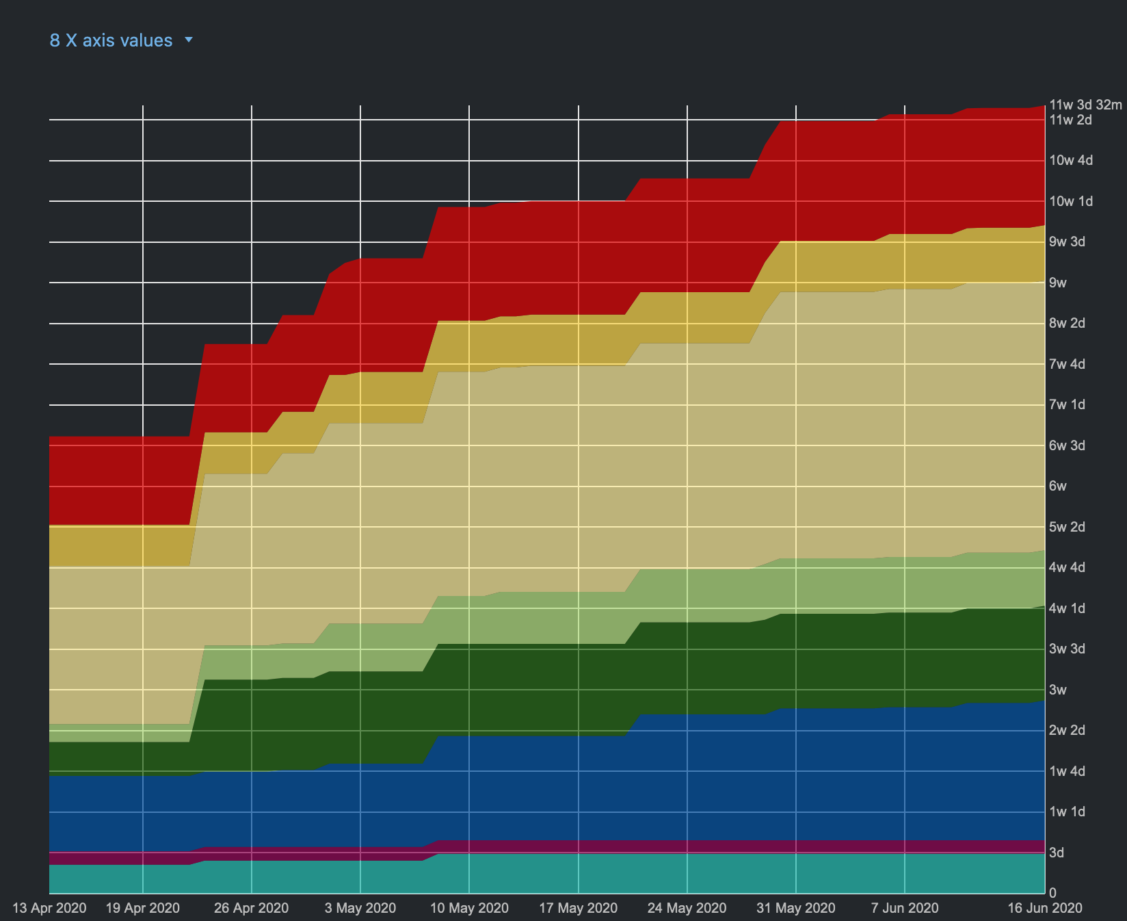
RUP- Workflow - 2020

Slide 13
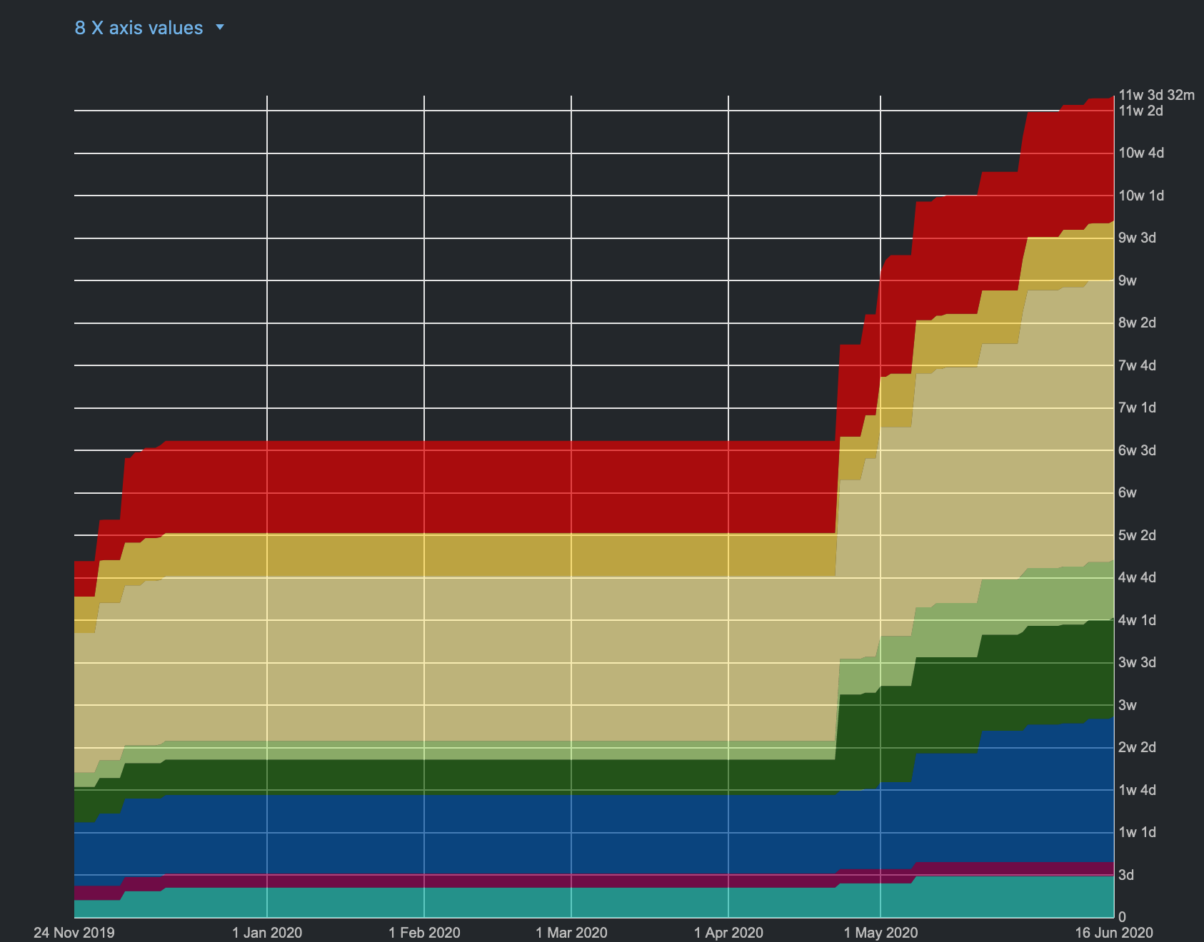
RUP- Workflow - complete
Notes:
Alex

Slide 14
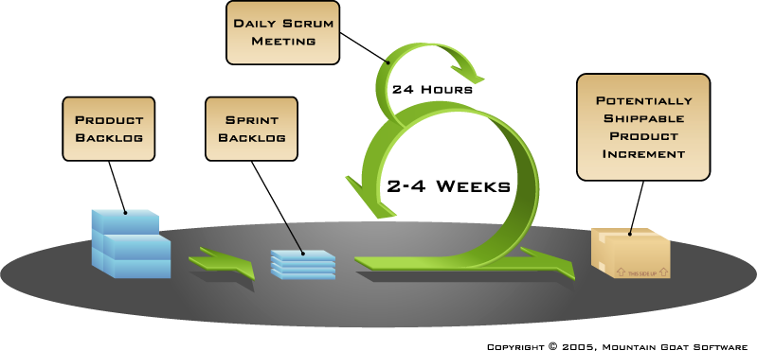
Scrum and Youtrack
weekly
Notes:
Jeanne: Youtrack integriert in IntelliJ als Plugin und in Git

Slide 15
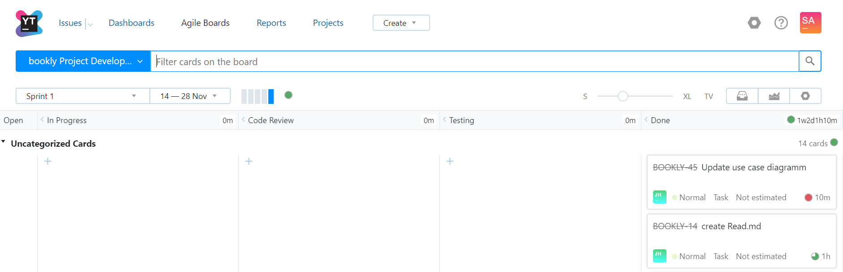
Scrum and Youtrack
Notes:
Jeanne

Slide 16
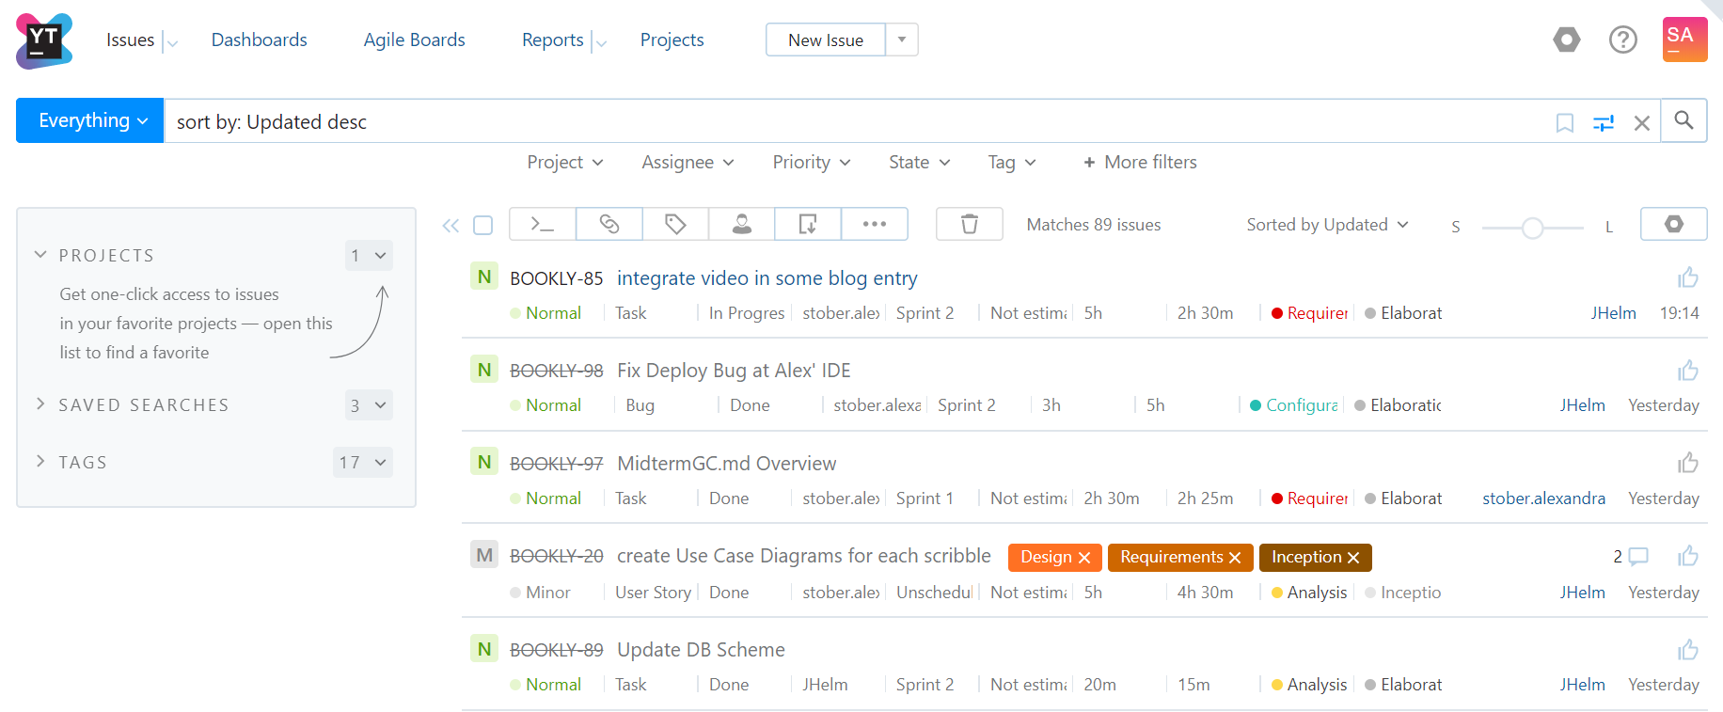
Scrum and Youtrack
Notes:
Jeanne

Slide 17
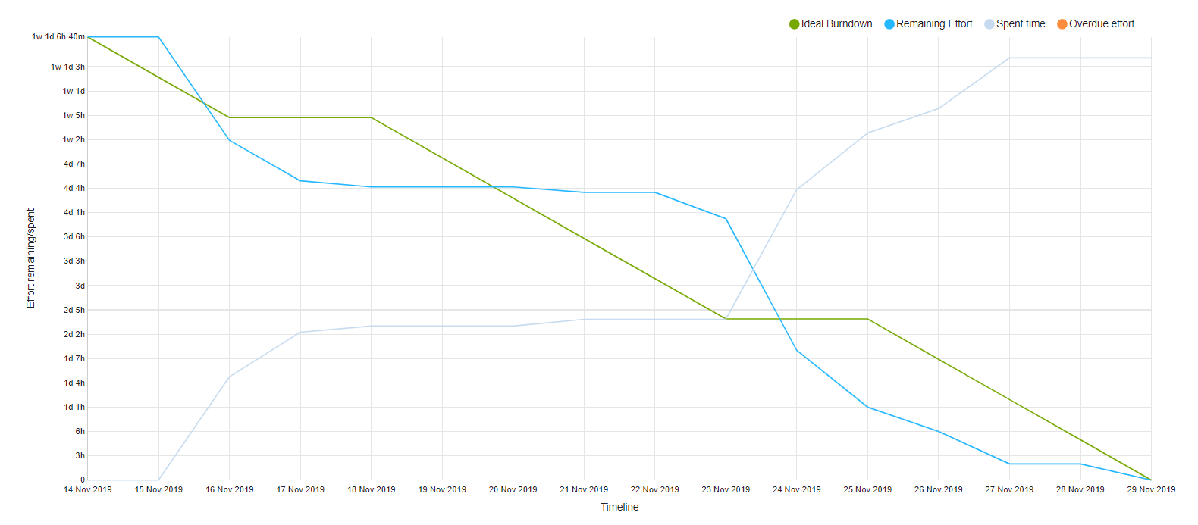
Burn-Down-Chart
► more
Notes:
Jeanne

Slide 18
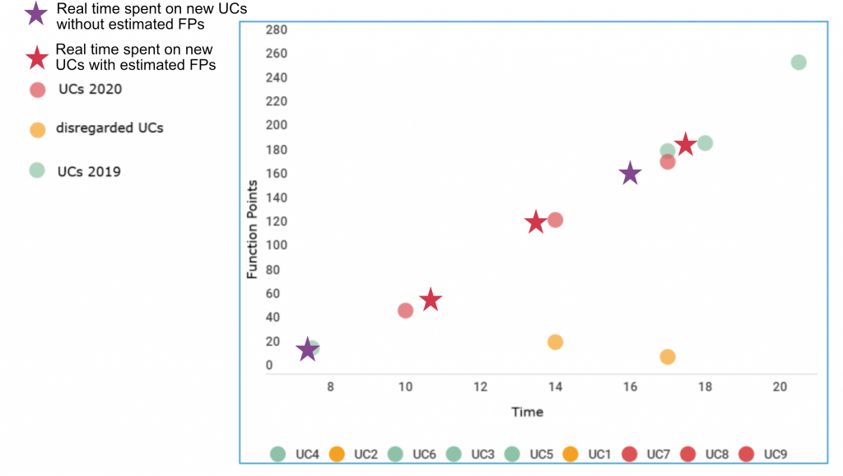
Cost Estimation
Notes:
Alex

Slide 19
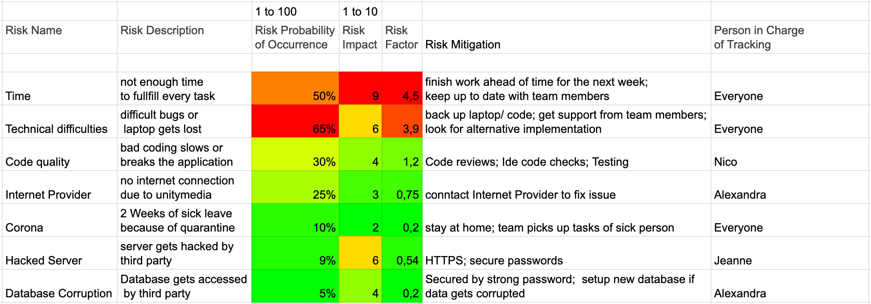
Risk Management
Risk Management ► here
Notes:
Alex

Slide 20
Architecture
Notes:
Alex

Slide 21

Main Idea

Slide 22
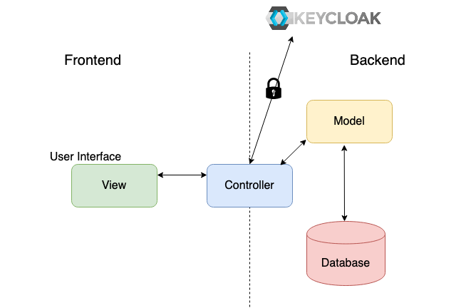
Overview
Notes:
Alex

Slide 23
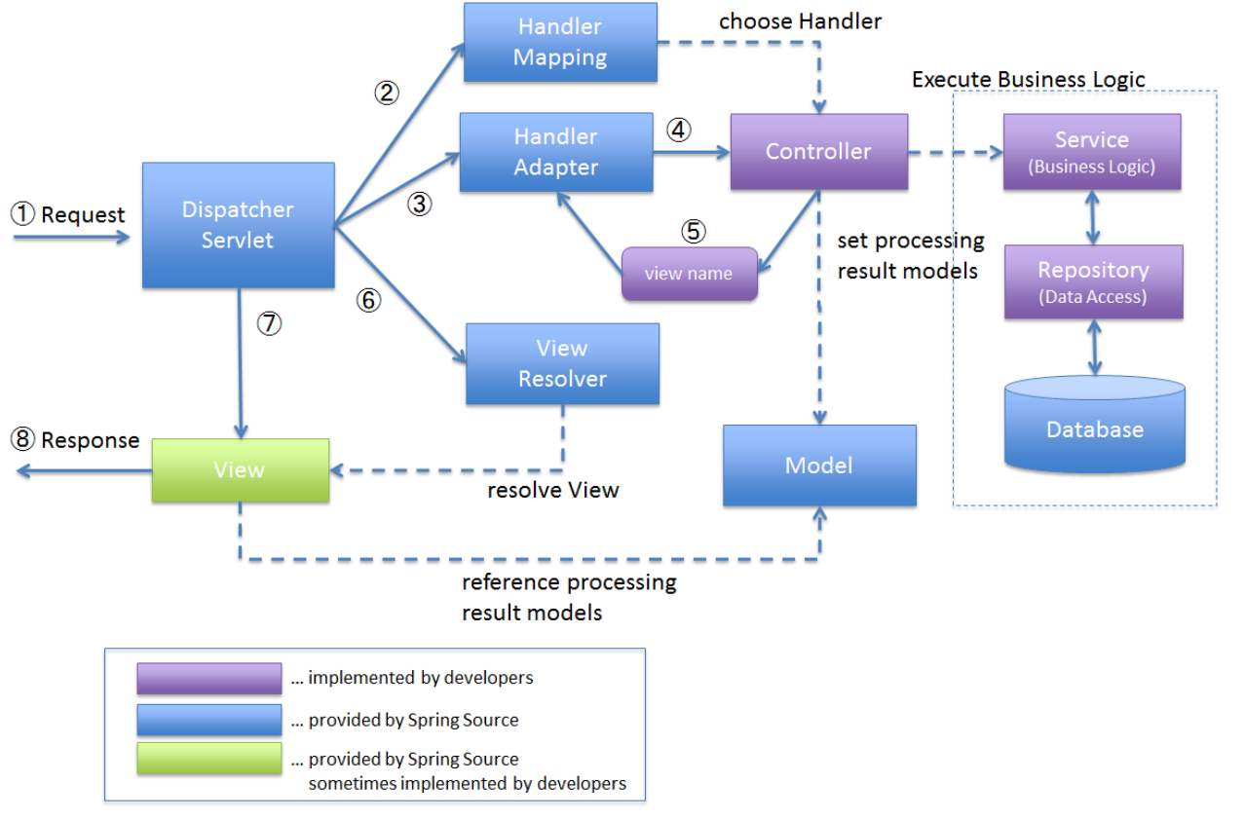
Architecture – Overview

Slide 24

















Technology
Backend
Frontend
Testing
Deployment
Notes:
Alex:

Slide 25
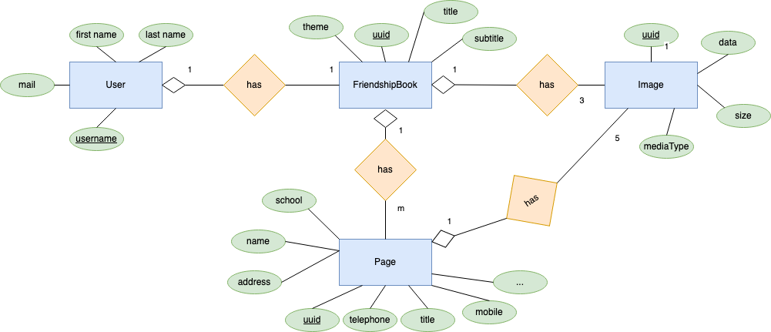
Database scheme – Data View
Notes:
Alex

Slide 26
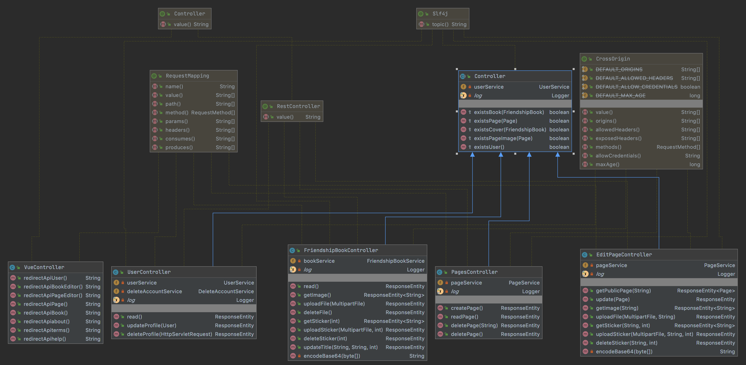
Class Diagram - Controller
Notes:
Jeanne

Slide 27
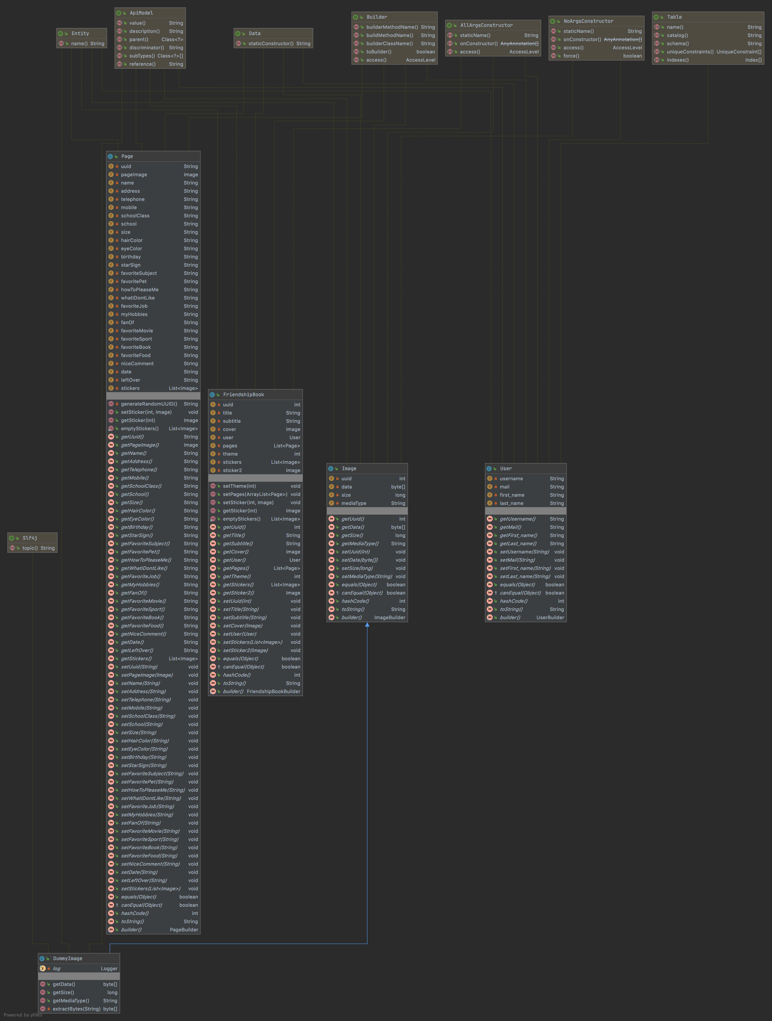
Class Diagram Model
►Whole view
Notes:
Jeanne

Slide 28
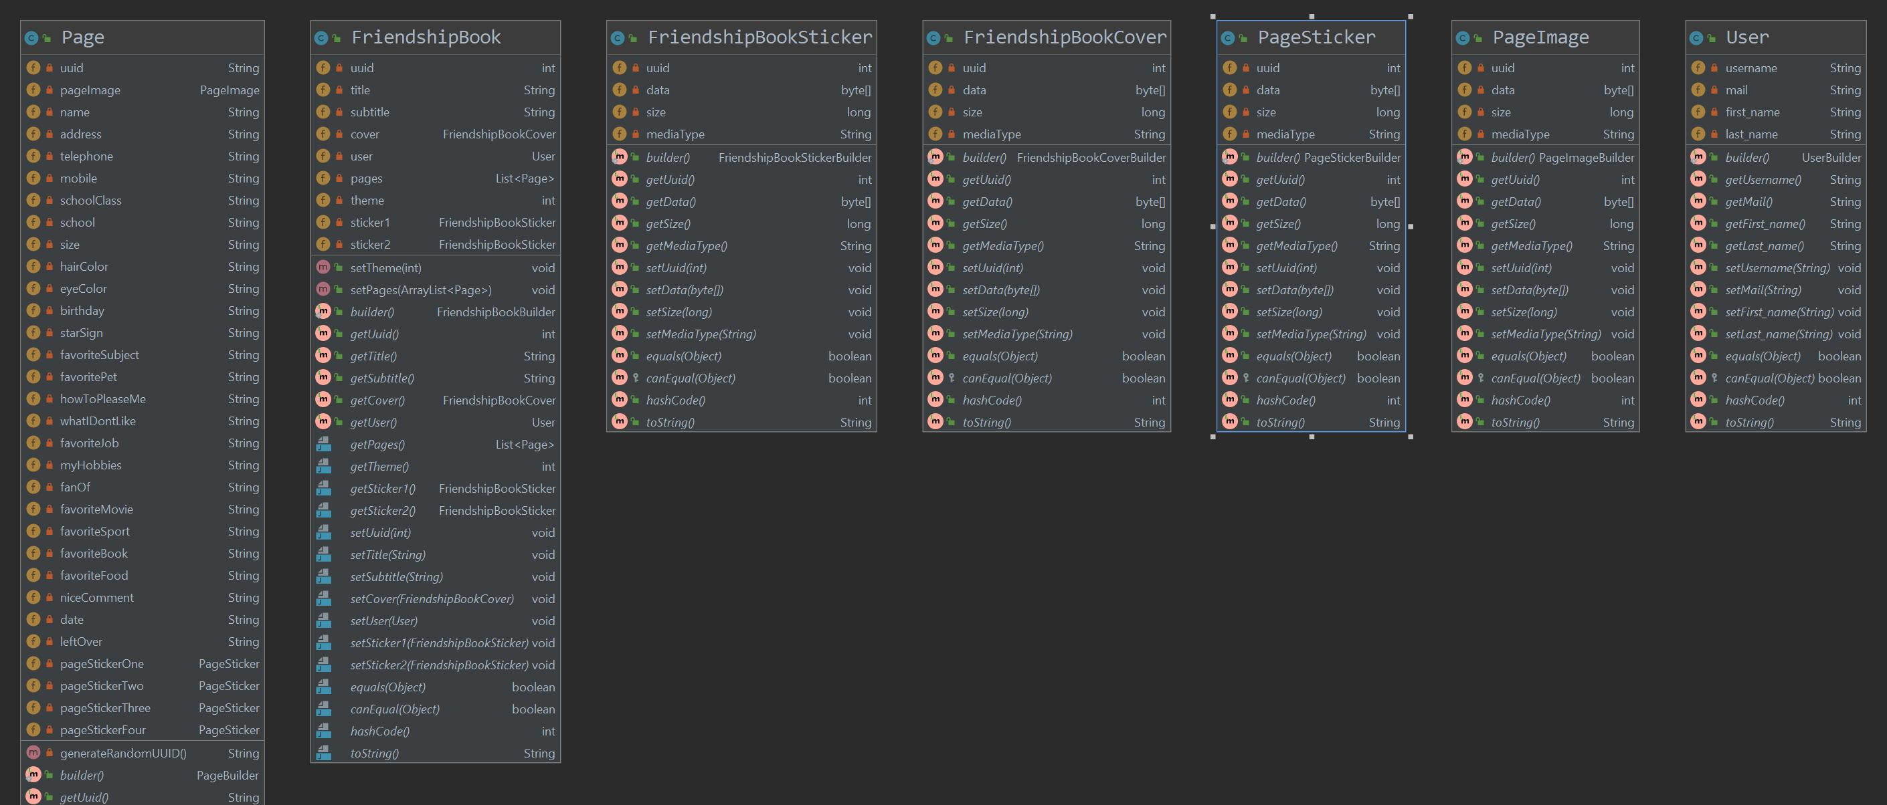
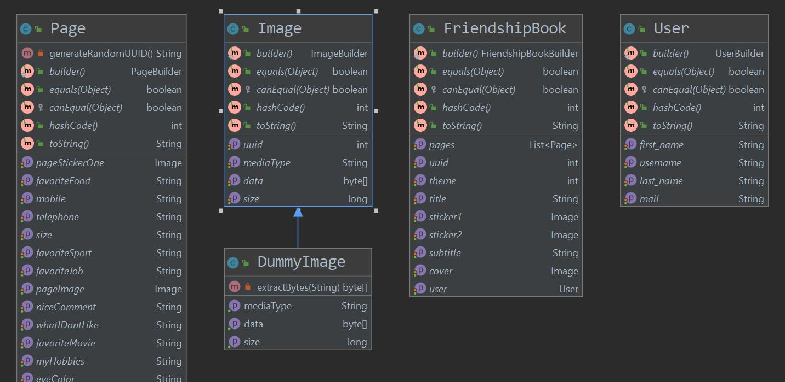
Design Patterns: Null Object
◀︎ before
After ▶︎
Notes:
Jeanne: dummy image hervorheben

Slide 29
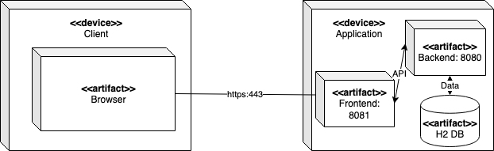
Architecture – Deployment View

Slide 30
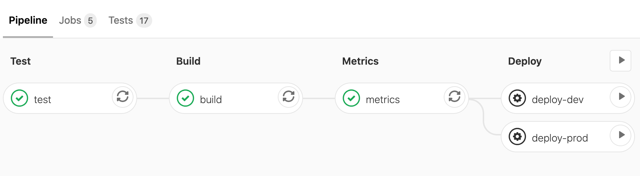
Continous Integration
Pipelines Test ► Build ► Metrics ► Deploy (automatic or manual)

Slide 31



Continous Integration
What | Code | Push to GitLab | Test Application | Metrics | Build Application | Deploy to Server
When | continously | Code is ready |  |  |  | + we decide
Where |  |  | ▼ ▼ | ▼ | ▼ | dev-system or stage-system
after
after
after
after
Notes:
Jeanne

Slide 32
QUality

Slide 33
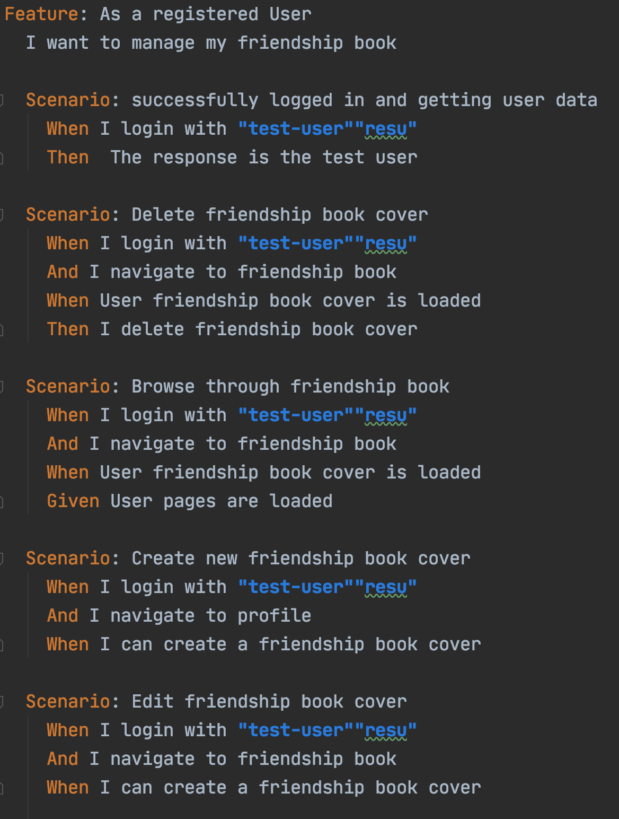

Testing
Automatic testing
Test results visible on GitLab per commit
BDD tests with cucumber
JUnit tests
Database tests
Field Test
Test Coverage
Notes:
Nico:
JUnit Tests: Service and Controller wurden getestet
Database Tests: Minor Service /Repo Tests
Behaviour Driven: Cucumber (Klicken -> Feature File Example)
Test Coverage: Jacoco berechnet das, mit Regex prozentzahl herausgefiltert und in Gitlab eingetragen. Sonarqube verwendet dieselbe Zahl
Field Tests: Erklären (Video + Google Umfrage) -> Schüler haben Pokemon-Zugangsdaten bekommen, Testen die Webseite anonym, Füllen die Umfrage aus. Es gibt eine Hilfsseite und ein Demovideo

Slide 34
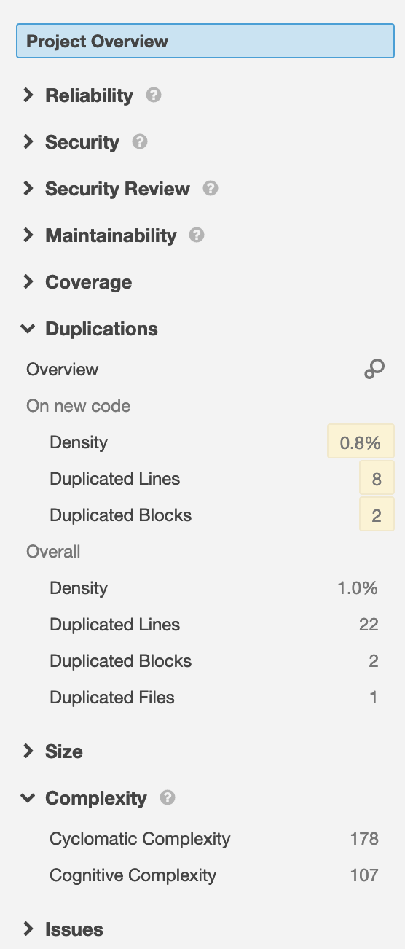
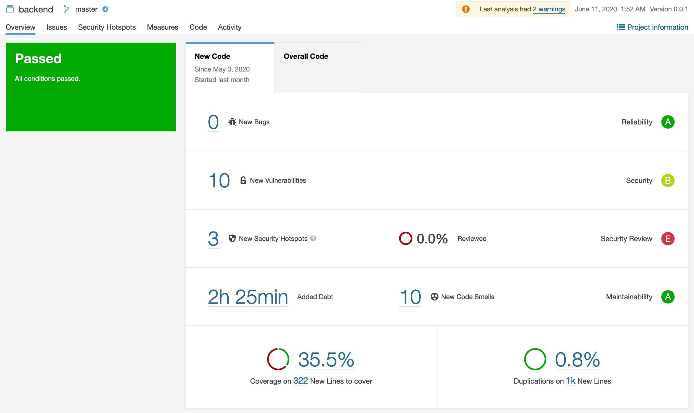
Metrics
▶︎Sonarqube
Notes:
Nico: Duplicated Lines (=Images und Sticker zu einem gemeinsamen Objekt zusammenfassen) und Cyclometic Complexity (=entfernen von If-Verschachtelungen)
Sonarqube läuft auf einem eigenen Server, aufrufbar unter folgendem Link NICHT DEN LINK ANKLICKEN; ENGLISCH REDEN

Slide 35
Further Questions?
Notes:
Nico

Slide 36
Bookly Documentation
Stage System
bookly.online
Documentation
SRS
SAD
Swagger
Testplan
Project Management and Quality
YouTrack
Blog
GitLab
SonarQube
Gantt Chart Time Estimation
Demo
Notes:
Nico: Weitere Links

